Slide 1


Algoritma pemrograman 3
PERTEMUAN KE – 2 (LOGIKA DAN TEKNIK PEMROGRAMAN COBOL)
PROGRAM STUDI INFORMATIKA
UNIVERSITAS GUNADARMA

Slide 2
R
P
S
01
04
Statement Dasar
Perform
02
Statement aritmatika
05
Table
03
Statement Lompatan

Slide 3
01
Statemen dasar pada Procedure Division

Slide 4

Move
Display
Memindahkan Nilai antar Data dengan tipe sama
Menampilkan hasil di monitor
Format : 1. MOVE nama-data-1/literal TO nama-data-2[ , nama-data-3 ]
2. MOVE Corresponding Tabel1 TO Tabel2.
Move A to B
Move ‘Santi’ to Nama1, Nama2
Move corresponding RecordMhs-in to RecordMhs-out
Format : 1. Display nama-layar
2. Display nama-data/literal[, nama-data-n/literal]
3. Display(x, y) nama-data/literal/erase
Display Layar. => nama layar di atur di screen section (data division)
Display nama, ‘ Budi’.
Accept
Memasukkan data lewat layar
Format :
Accept nama-data
Accept nama-layer [on escape statement imperative]
3. Accept(x, y) nama-data with Format-Isian
Accept nama data From Date/Day/Time/Escape-Key
Format-isian :: Zero-fill, space-fill, left-justified, right-justified
Trailing-sign, prompt, update, length-check,
empty-check,auto-skip, no-echo,beep

Slide 5
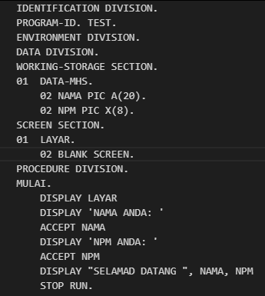

STOP
Menghentikan Pogram sementara/permanen
Format : 1. Stop Literal => sementara
2. Stop run => mengakhiri program
Contoh :
Stop ‘Tekan tombol untuk lanjut
Stop run.

Slide 6
02
STATEMENT ARITMATIKA

Slide 7

ADD
STATEMENT PENAMBAHAN
ADD A TO B => A = A+ B
ADD A, 5 TO B => B = A + 5 + B
ADD 2 TO B ROUNDED ON SIZE ERROR DISPLAY ‘HASIL SALAH’
ADD A, B GIVING C => C = A + B
ADD A, 7 GIVING C ROUNDED => C = A + 7 (HASIL DIBULATKAN)
SUBSTRACT A,B FROM C => C = C – B - A
SUBSTRACT A, 5 FROM D => D = D – 5 - A
SUBSTRACT A, 5 FROM C GIVING C => D = C – 5 - A
SUBSTRACT A FROM B GIVING C ROUNDED => PEMBULATAN
SUBSTRACT
STATEMENT PENGURANGAN

Slide 8


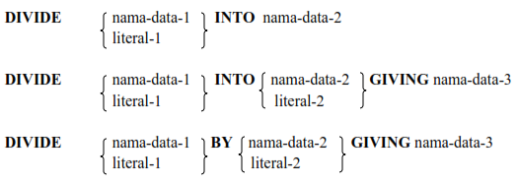
MULTIPLY
STATEMENT PERKALIAN
MULTIPLY A BY B => B = A * B
MULTIPLY A,6 BY B GIVINC C ROUNDED => C = A * 6 * B
DIVIDE A INTO B => B = B / A
DIVIDE 5 INTO B ROUNDED => B = B / 5 (DIBULATKAN)
DIVIDE 10 BY 2 GIVING A => A = 10 / 2
DIVIDE A BY B GIVING C ON SIZE ERROR DISPLAY ‘NO’
DIVIDE
STATEMENT PEMBAGIAN

Slide 9
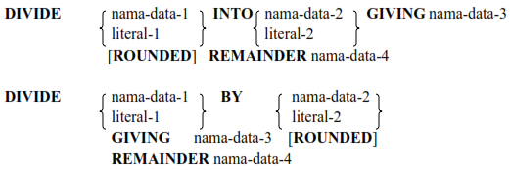

DIVIDE
STATEMENT PEMBAGIAN
DIVIDE A INTO B GIVING C REMINDER D
=> C = B / A
hasil simpan di C
sisa hasil bagi simpan di D
berlaku jika var menyimpan hasil bagi bentuk pecahan
COMPUTE A ROUNDED = A + B ** 2
Pada DIVIDE juga terdapat ROUNDED dan ONSIZE ERROR
COMPUTE

Slide 10
03
Statement Lompatan

Slide 11
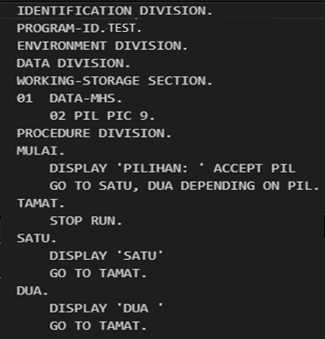


GO TO
STATEMEN LOMPATAN
GO TO
Alih tanpa syarat
Format : Go To nama-paragraph
GO TO DEPENDING ON
Alih control bersyatar
Format : Go To nama-paragraph1, nama-paragraph2..
nama-paragraph-n DEPENDING ON
1
2

Slide 12
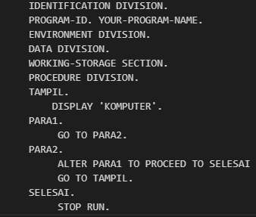


alter
Merubah arah tujuan proses dari statement GO TO
Format :
Hasil :

Slide 13

PERFORM
Membuat suatu statement yang akan membawa proses dari program meloncat ke suatu paragraph,
Menjalankan seluruh statetement yang ada pada paragraph tersebut. Jika telah selesai akan kembali ke statement setelah PERFORM.
Format:

Slide 14
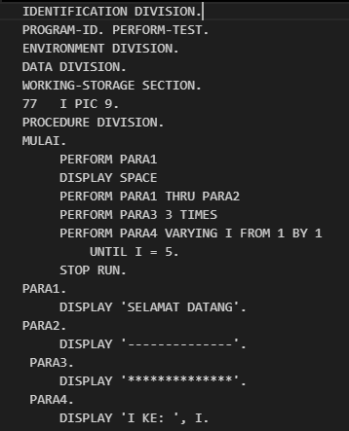


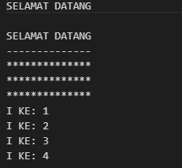
PERFORM lanjutan

Slide 15
04
TABEL

Slide 16
TABEL
SUATU KUMPULAN DATA DENGAN TIPE SAMA DAN DISIMPAN DI MEMORI SECARA BERURUTAN
Menggunakan statement OCCURS
Occurs clause tidak boleh dipakai pada level number 01 atau level number77
Pendefinisian Tabel ada pada DATA DIVISION di WORKING-STORAGE SECTION.
DIMENSI 1
DIMENSI 2
Contoh 1 :
01 tabel-Mahasiswa.
02 Nama Occurs 5 times pic A(20).
02 NPM Occurs 5 times pic X(8).
Contoh 2:
01 tabel-Mahasiswa.
02 Data-Mhs Occurs 5
03 Nama pic A(20).
03 NPM pic X(8).
Contoh 1:
01 Penjualan
02 Salesmen Occurs 2 Times.
03 Bulan Occurs 3 Times Pic 9(5).
Contoh :
01 Penjualan
02 Salesmen Occurs 2 Times.
03 Bulan Occurs 3 Times.
04 Hasil Pic 9(5).

Slide 17
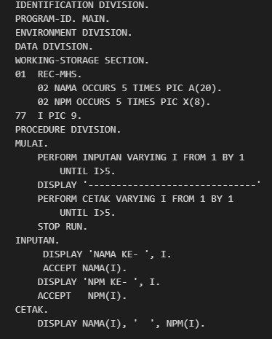
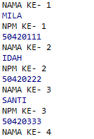
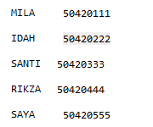
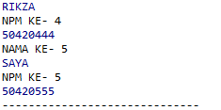
CONTOH TABEL DIMENSI 1
Please enter your title content
Input the text content you want according to the content you need, and input the text and other information.Input the text content you want according to the content you need, and input the text and other information.Input the text content you want according to the content you need, and input the text and other information.

Slide 18
Terima
kasih
Tim Penyusun:
1.
2.
3
PROGRAM STUDI INFORMATIKA
UNIVERSITAS GUNADARMA

